Slide 1

Introduction to Deep Learning
Neural networks, computation, optimization
Yordan Darakchiev
Technical Trainer
iordan93@gmail.com

Slide 2
sli.do
#DeepLearning

Slide 3
Table of Contents
Computational graphs
Simple models with tensorflow
  Low-level API
Building neural networks
Regularization

Slide 4
Computational Graphs
Performing simple calculations…
just harder

Slide 5
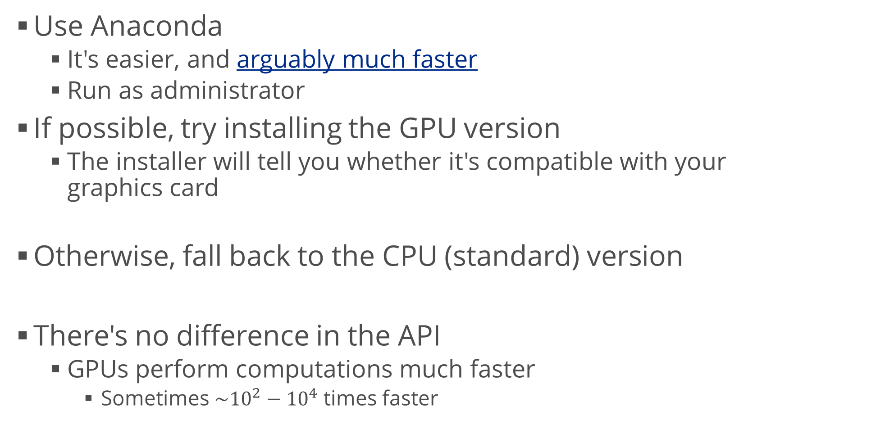
Installing tensorflow
Use Anaconda
  It's easier, and arguably much faster
  Run as administrator
If possible, try installing the GPU version
  The installer will tell you whether it's compatible with your
  graphics card
Otherwise, fall back to the CPU (standard) version
There's no difference in the API
  GPUs perform computations much faster
    Sometimes $\sim {10}^{2}−{10}^{4}$ times faster
conda install tensorflow-gpu
conda install tensorflow

Slide 6



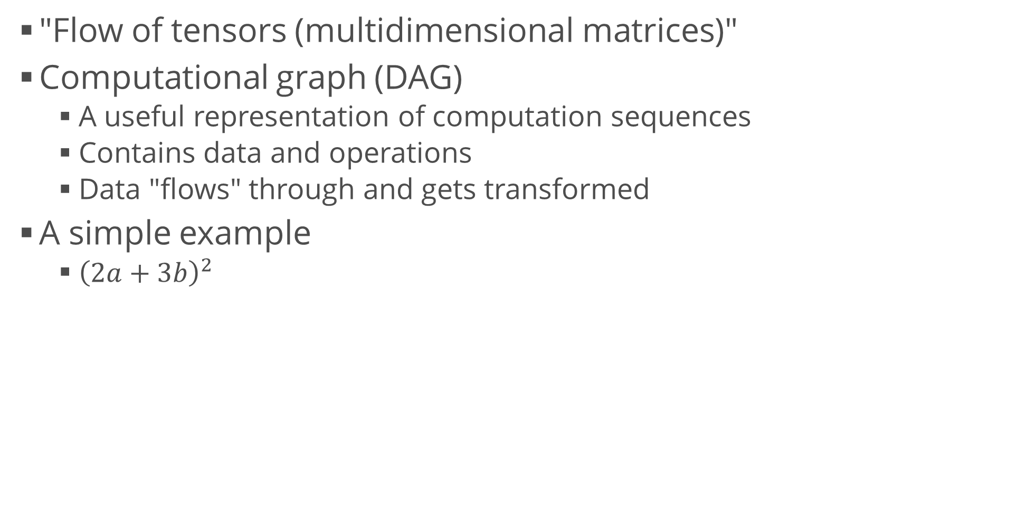



Computational Graphs in tensorflow
"Flow of tensors (multidimensional matrices)"
Computational graph (DAG)
  A useful representation of computation sequences
  Contains data and operations
  Data "flows" through and gets transformed
A simple example
  ${\left(2a+3b\right)}^{2}$
$$a$$
$$2(⋅)$$
$$+$$
$${(⋅)}^{2}$$
result
$$b$$
$$3(⋅)$$

Slide 7

Computational Graphs in tensorflow (2)
Import the library
Create two constants for $a$ and $b$
  We will provide their values later to get the result
Create the function
  Using tensorflow operations
import tensorflow as tf
a = tf.constant(2)
b = tf.constant(3)
def compute(a, b):
return tf.pow(
tf.add(
tf.multiply(2, a),
tf.multiply(3, b)
),
2)

Slide 8
Computational Graphs in tensorflow (3)
However, it can be much, much simpler!
This works in regular Python, numpy, and tensorflow
  Depends on the types of a and b
def compute(a, b):
return (2 * a + 3 * b) ** 2
compute(2, 3)# 169
compute(2.0, 3.0) # 169.0
compute(np.array([2, 3, 4]), np.array([3, 4, 5]))
# array([169, 324, 529], dtype=int32)
compute(tf.constant(2), tf.constant(3))
# <tf.Tensor: id=53, shape=(), dtype=int32, numpy=169>
compute(tf.constant([2, 3, 4]), tf.constant([3, 4, 5]))
# <tf.Tensor: id=62, shape=(3,), dtype=int32,
# numpy=array([169, 324, 529])>

Slide 9
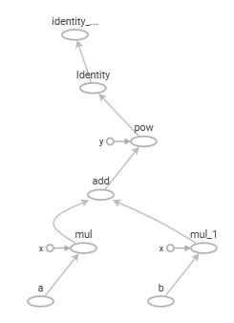
Visualizing the Graph
Decorate the function with
Trace the execution
Run tensorboard to visualize the graph
and function trace
@tf.function
a, b = tf.constant([2, 3, 4]), tf.constant([3, 4, 5])
tf.summary.trace_on(graph = True, profiler = True)
result = compute(a, b)
print(result.numpy())
with writer.as_default():
tf.summary.trace_export(
name = "compute_trace",
step = 0,
profiler_outdir = "logs")
tensorboard --logdir logs

Slide 10
Linear Models
Logistic regression using tensorflow

Slide 11
Logistic Regression
Data: Iris dataset
Prepare the output – one-hot encoding
Define the model
  I'm doing the 3 LRs at once (with the same inputs)
    Equivalent results to scikit-learn's one-vs-rest strategy
  We can inspect it after that
from sklearn.datasets import load_iris
iris = load_iris()
attributes, labels = iris.data, iris.target
labels_onehot = tf.one_hot(labels, depth = 3).numpy()
model = tf.keras.models.Sequential([
tf.keras.layers.Input(shape = (4,)), # Not required
tf.keras.layers.Dense(3, activation = "sigmoid")
])

Slide 12
Logistic Regression (2)
Compile the model
  Specify the loss function
Fit the model
  Of course, you can use train / test splits, etc.
View the results and see some metrics
model.compile(optimizer = "adam", loss = "categorical_crossentropy")
model.fit(attributes, labels_onehot, epochs = 50)
predictions = model.predict(attributes)
acc = tf.metrics.categorical_accuracy(
labels_onehot,
model.predict(attributes))
print(tf.math.reduce_mean(acc).numpy())
# or add, metrics = ["categorical_accuracy"] to model.compile()

Slide 13
Neural Networks
Going deeper

Slide 14
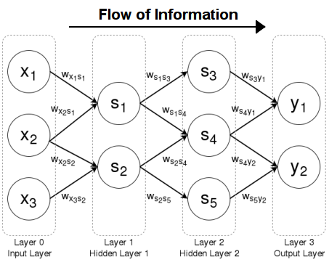
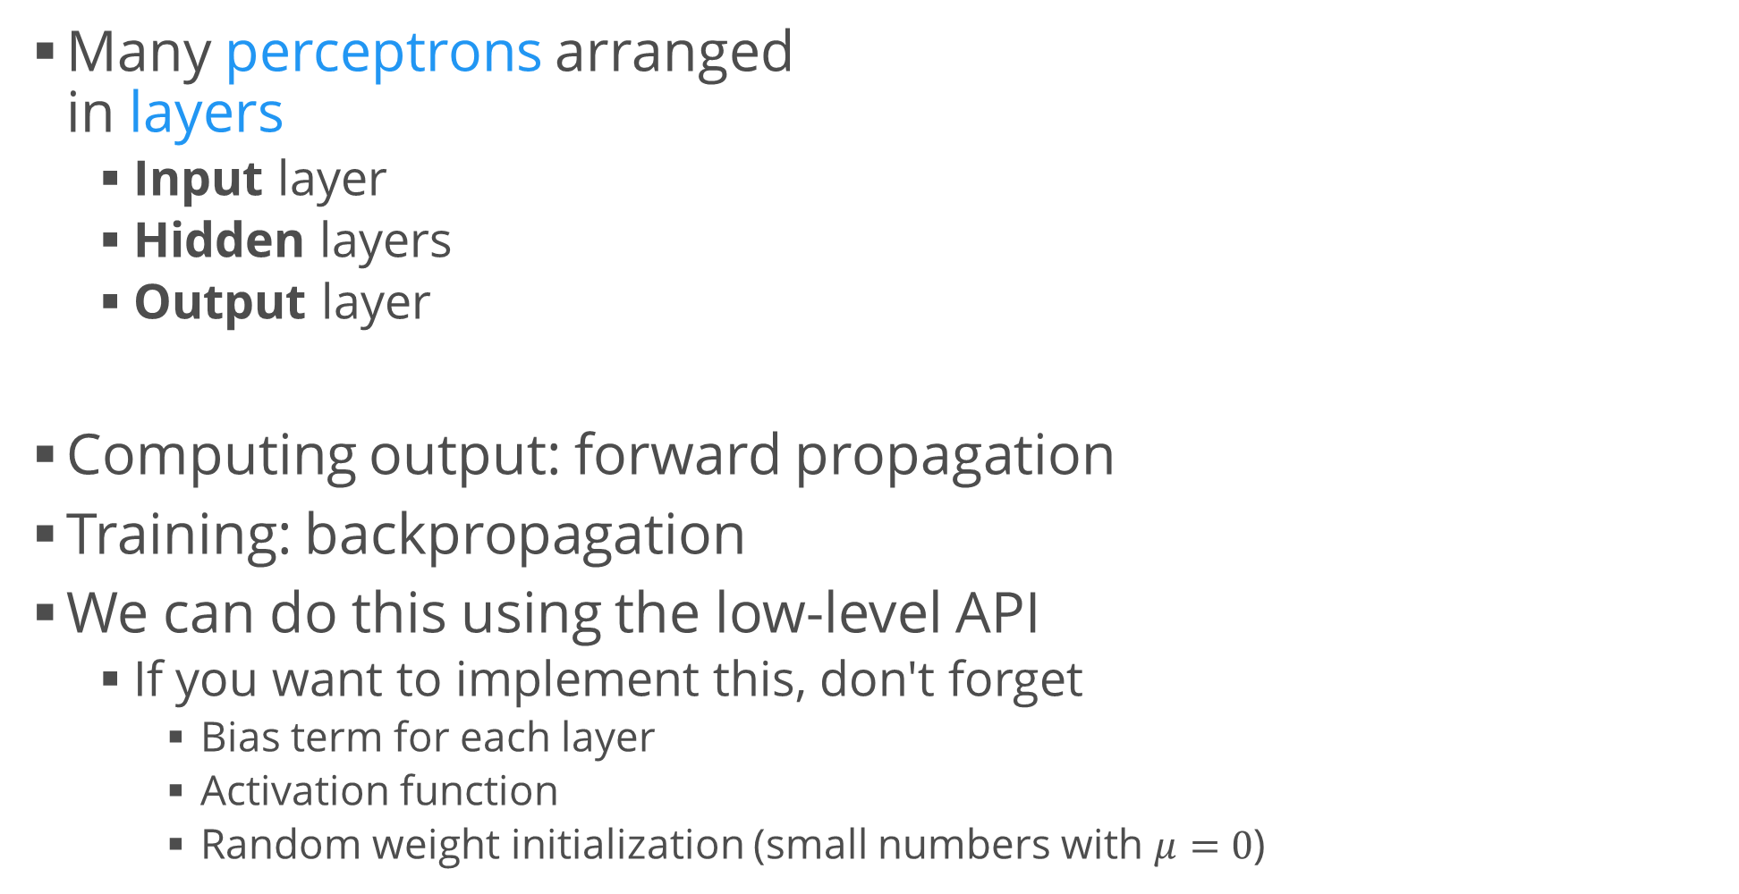
Deep Feed-Forward Neural Network
Many perceptrons arranged
in layers
  Input layer
  Hidden layers
  Output layer
Computing output: forward propagation
Training: backpropagation
We can do this using the low-level API
  If you want to implement this, don't forget
    Bias term for each layer
    Activation function
    Random weight initialization (small numbers with $μ=0$)

Slide 15
Example: MNIST
Load and normalize the data
Create and evaluate the model
mnist = tf.keras.datasets.mnist
(x_train, y_train), (x_test, y_test) = mnist.load_data()
x_train, x_test = x_train / 255.0, x_test / 255.0
model = Sequential([
Flatten(),
Dense(512, activation = "relu"),
Dropout(0.2),
Dense(10, activation = "softmax")])
model.compile(
optimizer = "adam",
loss = "sparse_categorical_crossentropy",
metrics = ["accuracy"])
model.fit(x_train, y_train, epochs = 5)
model.evaluate(x_test, y_test)
# or add validation_data = (x_test, y_test) to model.fit()

Slide 16
Summary
Computational graphs
Simple models with tensorflow
  Low-level API
Building neural networks
Regularization

